Slide 1
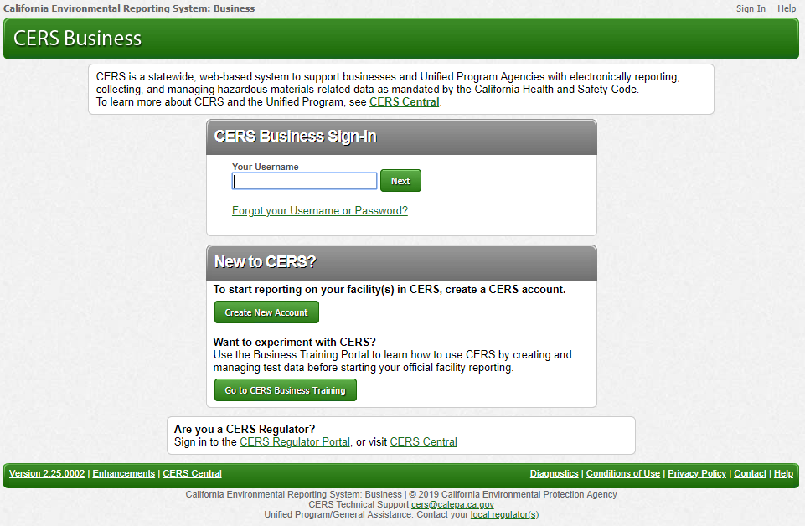
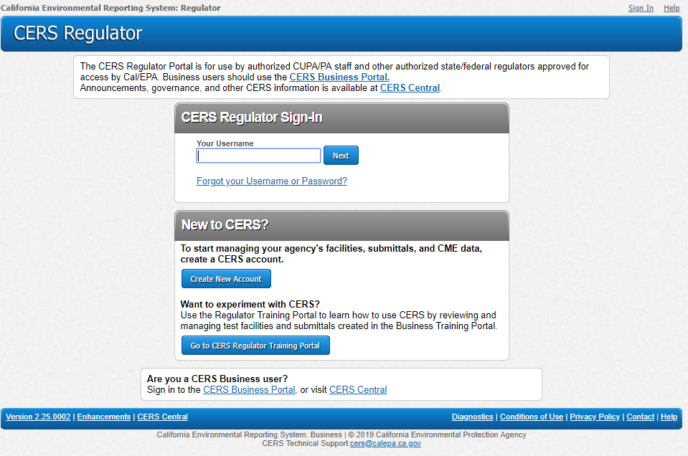
How Does CERS 3 Impact Me?
Notes:
Calepa Unified Program IT

Slide 2
Introduction
SCRUM
Why CERS 3 Features
Requirements of state and federal laws
Timeline
Who Is Impacted and How?
What Processes are Impacted?

Slide 3
Introduction
CERS 3 Technical Team
Manoj Beeravelli – Manager
John Miller – Programmer
Hien Pham – Programmer
Ke Chen – Programmer
Cathie Rolfes – Analyst
Jessie Perez – Analyst

Slide 4
Introduction
CERS 3 Unified Program Team
John Paine – Manager
Melinda Blum – Sr. Environmental Scientist
CERS 3 Subject Matter Experts
APSA (Aboveground Petroleum Storage Act)
Jennifer Lorenzo – Sr. Environmental Scientist Supervisor,
Office of the State Fire Marshall
UST (Underground Storage Tanks) and CME (Compliance, Monitoring, and Enforcement)
Tom Henderson – Engineering Geologist, Waterboards
Lisa Jensen – Environmental Scientist, Waterboards
Laura Fisher – Manager, Waterboards
Special Thanks to Dan Firth, Jim Bohon and extended team (testers, CUPA reps)
for their expertise and contributions

Slide 5
SCRUM: It’s about common sense
Is an agile, lightweight process
Uses iterative, incremental practices: SPRINTS
Has a simple implementation
Increases productivity
Embraces adaptive, empirical systems development

Slide 6
Agile Manifesto
Individuals and Interactions
Over
Process and tools
Customer collaboration
Over
Contract negotiation
Responding to change
Over
Following a plan

Slide 7
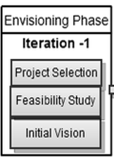
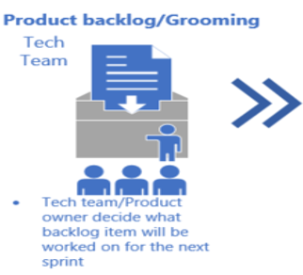
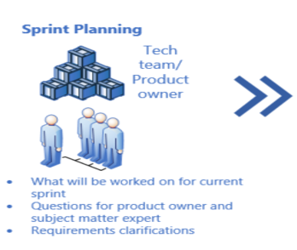
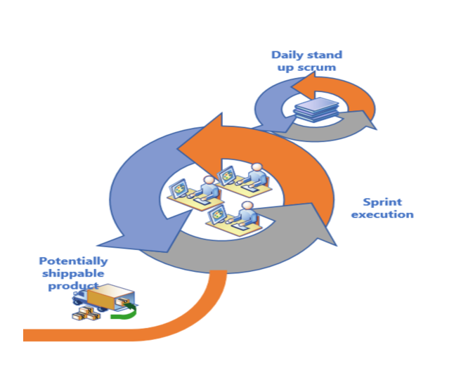
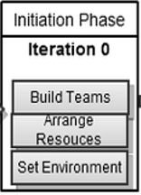
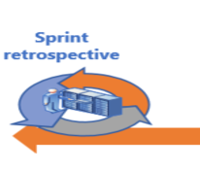
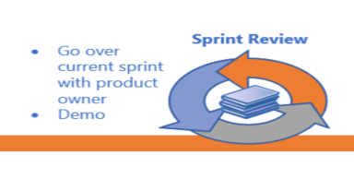
SCRUM at a Glance

Slide 8
Timeline

Slide 9
Deployment Plan
Next Step:
Training environment deployment– (2/8/2019)
Users testing – (2/11/2019 – 2/22/2019)
EDT users community bi-weekly meeting
Ongoing Demo to Regulators and CUPAs
Ongoing Demo to Business Users (PGE, AT&T…etc)
Staging deployment – 2/22/2019
Production deployment – 3/28/2019

Slide 10
CERS 3 Enhancements:
Who Is Impacted and How?
Businesses or Regulators

Slide 11
CERS 3 Enhancements: Who Is Impacted and How?
APSA – AST (Aboveground Petroleum Storage)
Regulators that manage APSA facilities
Vendors that have EDT interface software that submits APSA submittals
All businesses that are required to report on APSA
UST (Underground Storage Tank)
All businesses that are required to report on UST
Regulators that manage UST facilities
Vendors that have EDT interface software that submits UST submittals
CME
Regulator staff, such as inspectors, that manage CME data in CERS for their facilities
Unified Program staff that manage CME
Reports
Regulators that use CERS reports
Unified Program staff that use CERS reports
Business users that print submittals
Regulator users that print submittals
Any other Cal EPA staff (i.e., Waterboards for UST, Cal Fire for APSA) that rely on CERS reports

Slide 12
CERS 3 Project
What Processes are Impacted?

Slide 13
What Processes are Impacted?
Aboveground Petroleum Storage Act Submittals
New APSA Facility Information Submittal Element Resource
Added a new web form (user interface) with 4 new data elements to support APSA Facility Information reporting
Conditionally Exempt APSA Tank Facility (data element 800)
Date of SPCC Plan Certification or Date of 5-Year Review (data element 801)
Total Aboveground Storage Capacity of Petroleum (data element 802)
Number of Tanks in Underground Areas (data element 803)
Document Upload resource still required
Updated APSA reporting criteria question on Business Activities form:
CERS 2 CERS 3
Notes:
New Resource: New data fields allow reporting capability on APSA facilities – did not exist before, only document upload ( Add users interface as a bullet item

Slide 14
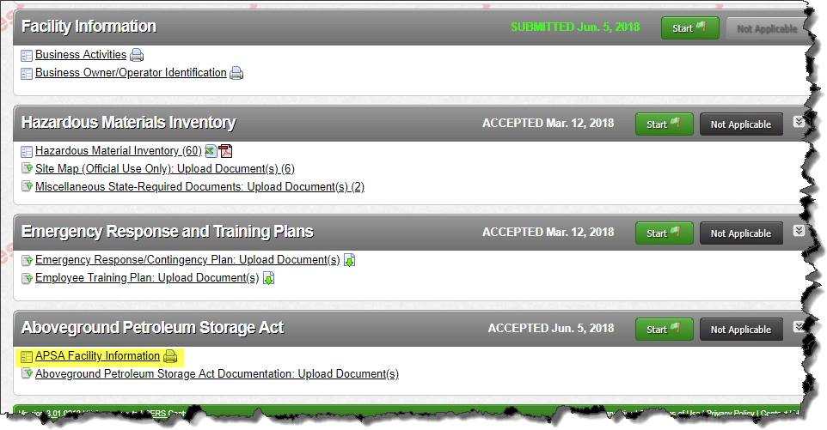
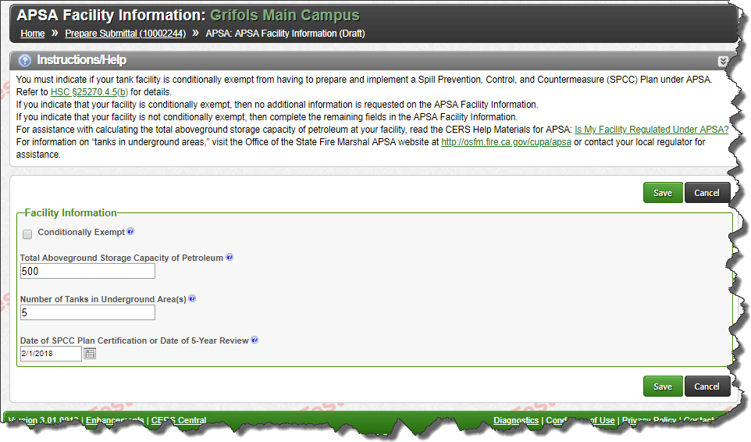
What Processes are Impacted?
Aboveground Petroleum Storage Act Submittals
New APSA Facility Information Submittal Element Resource
Business Portal
Submittal Preparation APSA Facility Information

Slide 15
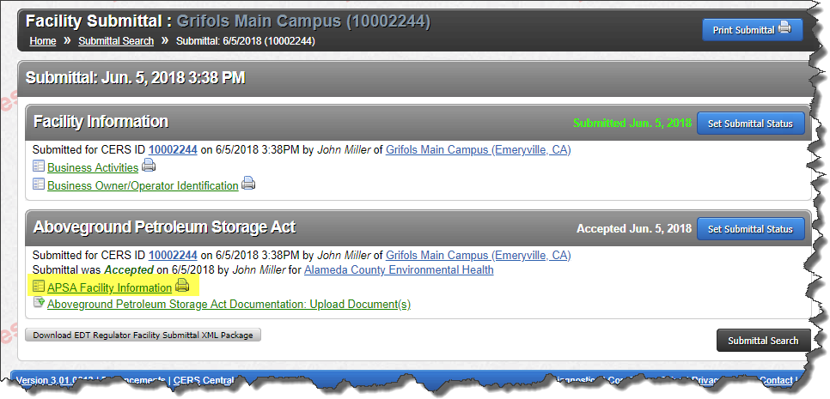
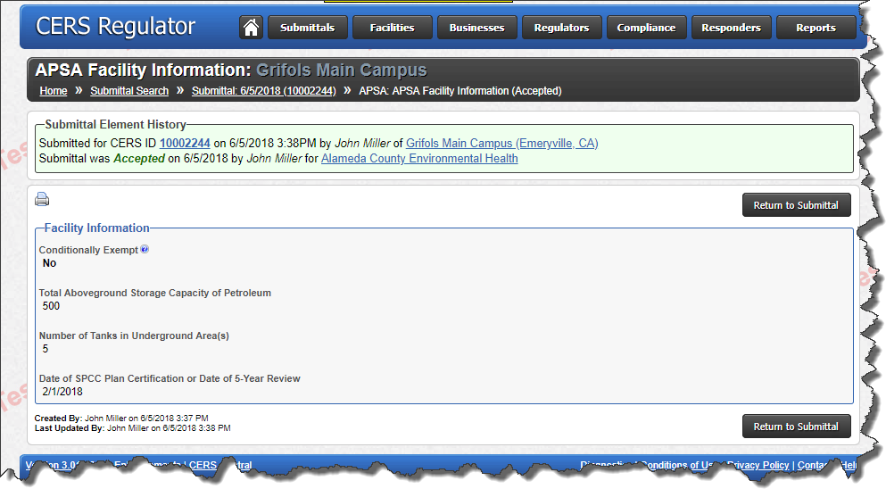
What Processes are Impacted?
Aboveground Petroleum Storage Act Submittals
New APSA Facility Information Submittal Element Resource
Regulator Portal
Facility Submittal APSA Facility Information

Slide 16
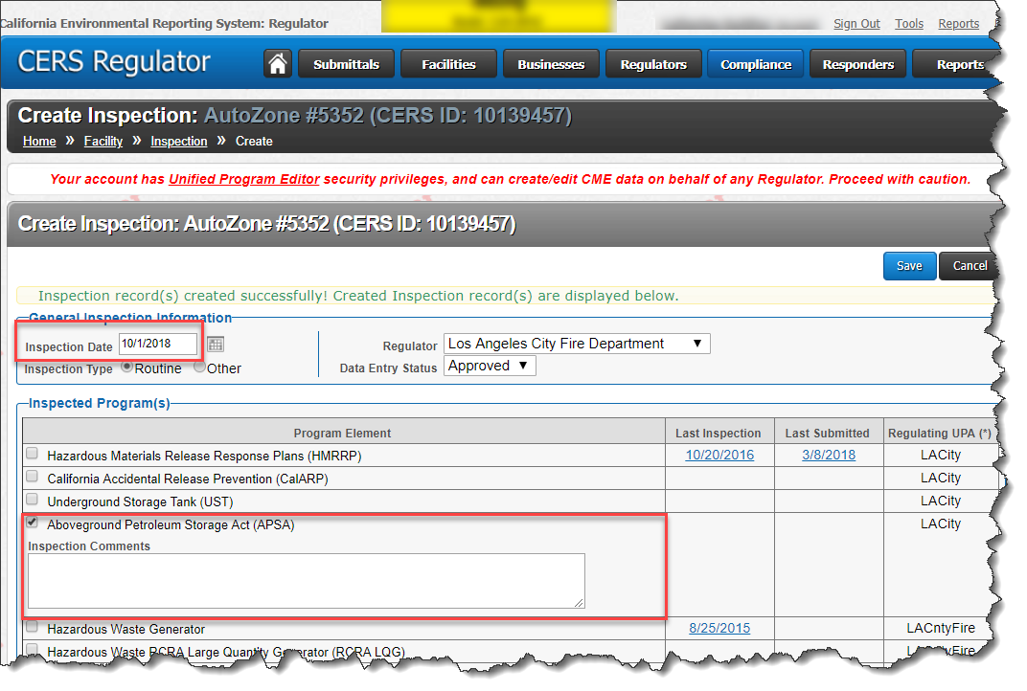
What Processes are Impacted?
Underground Storage Tanks Submittals
CERS Tank ID – New Data Element 432-a (in addition to 432)
Unique CERS Tank ID will allow better tracking/reporting for USTs and reduce or eliminate occurrences of duplicate USTs in CERS
All new and legacy USTs will be assigned a unique CERS Tank ID
CERS Tank ID will never change, even if the tank changes owners or facilities via Split Facility process
The number will be non-editable and can only be generated by CERS, similar to a facility CERS ID
Format: Current facility CERS ID + 3 digit incremental number
CERS ID 10023456 Tank 1: 10023456-001
CERS ID 10023456 Tank 2: 10023456-002
CERS ID 10023456 Tank 3: 10023456-003
Etc…
Processes added to UI to encourage proper reporting of on active USTs (ex: draft submittal will be pre-populated with active tank from last accepted submittal)
Validation/guidance messages will be generated for invalid CERS Tank IDs and active tanks that are not properly accounted for on current submittal (UI and EDT)
Logic/processes added to support “Split Facility” process
Notes:
CERS Tank ID vs Tank ID: Unlike the current user defined Tank ID that is not forced to be unique and can be assigned virtually any value by the user, the CERS Tank ID is unique and will enable better tracking of USTs in CERS as entities, cleaner and more accurate reporting, and reduce or eliminate the occurrences of duplicate tanks due to incorrect Tank ID assignments by users.
Active Tanks (i.e., any tanks that were reported as active on last accepted submittal by either current or previous owner): Add’l business processes added to encourage proper reporting/processing of tanks (i.e., Active tanks added to current submittal by default) and support Split Facility process
Split Facility: Explain Gas/Service Station Split Facility scenario; original business has 2 gas tanks and 1 waste oil tank, second business buys service station business and takes ownership of waste oil tank, original facility retains gas tanks.
CERS Tank ID assignment: New CERS Tank ID generated by CERS during submittal prep, legacy USTs will be assigned IDs retroactively
CERS Tank ID Format: ID does not necessarily reflect # of tanks or the CERS ID of the reporting facility

Slide 17
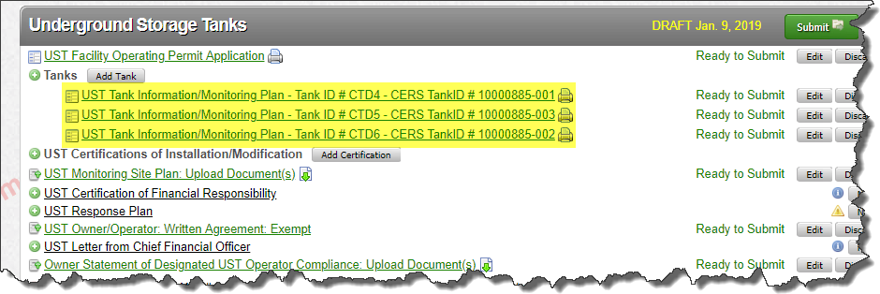
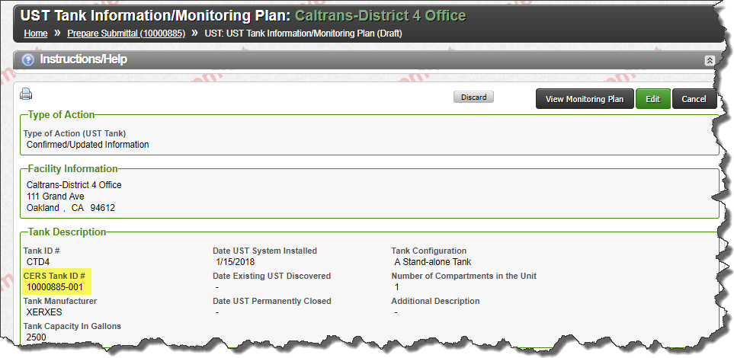
What Processes are Impacted?
Underground Storage Tanks Submittals: CERS Tank ID – New Data Element 432-a
Business portal
Submittal Preparation UST Tank Information

Slide 18
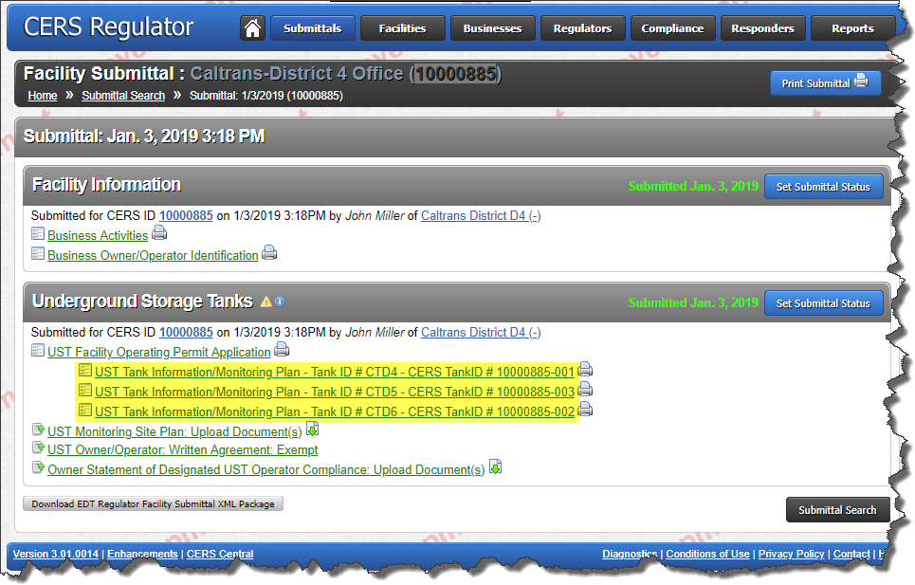
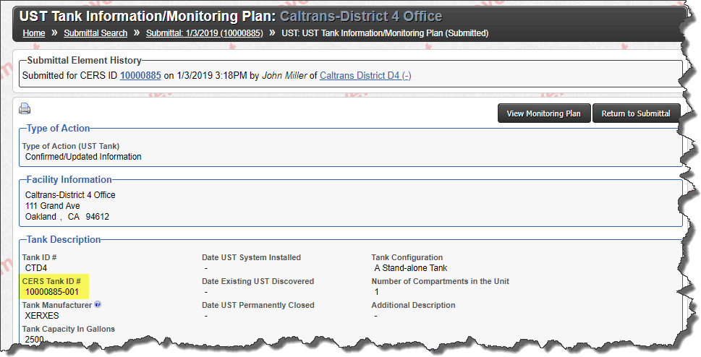
What Processes are Impacted?
Underground Storage Tanks Submittals: CERS Tank ID – New Data Element 432-a
Regulator portal
Facility Submittal (UST Submittal Element) UST Tank Information

Slide 19
What Processes are Impacted?
Underground Storage Tanks Submittals: CERS Tank ID – New Data Element 432-a
Regulator portal
CERS 3 UST Reports will use the CERS Tank ID as the key - CERS 2 reports used Tank ID which was prone to reporting errors
UST Facility/Tank Data Download Report
Notes:
Reporting errors: Duplicate tanks due to different Tank IDs assigned to the same tank

Slide 20
What Processes are Impacted?
Underground Storage Tanks Submittals
Added New Data Element Codes for Data Element 430 – Type of Action UST
AST Change to UST
Allow transfer of storage tank from AST program to UST program
Effective transfer date = Submittal Accepted Date + Type of Action = AST Change to UST
UST Change to AST
Allow transfer of storage tank from UST program to AST program
Support for UST to AST transfer project affecting several thousand storage tanks
Storage tanks will remain in UST reports for tracking purposes, but will not count as active USTs
Effective transfer date = Submittal Accepted Date + Type of Action = UST Change to AST
Purpose is to allow reporting of Tanks in underground areas (TIUGA)
Split Facility
Allow a business/facility to assume Owner/Operator and reporting responsibilities for one or more USTs previously reported by an existing CERS facility
Notes:
Split Facility: Explain Gas/Service Station Split Facility scenario; original business has 2 gas tanks and 1 waste oil tank, second business buys service station business and takes ownership of waste oil tank, original facility retains gas tanks.
Split Facility Process: Facility A report as Split Facility, submittal accepted, Facility B specifies CERS ID of Facility A, selects 1 or more available tanks from list; only tanks reported as “Split Facility” by Facility A will be available.

Slide 21
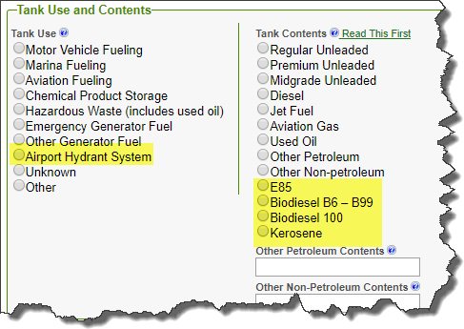
What Processes are Impacted?
Underground Storage Tanks Submittals
Added New Data Element Codes for Data Element 439 – Tank Use
Airport Hydrant System
Added New Data Element Codes for Data Element 440 – Tank Contents
E85
Biodiesel B6 – B99
Biodiesel 100
Kerosene
Obsoleted Data Element Codes for Data Element 440 – Tank Contents
Petroleum Blend Fuel
Ethanol
Notes:
Data element code changes: All affected EDT/XSDs

Slide 22
What Processes are Impacted?
Underground Storage Tanks Submittals
Updated Data Element 421 – BOE Number
BOE Changed the format of their number system
Field length lengthened from 8 to 9
New format will be 9 digits: XXXXXXXXX
CERS will accept both current format (44XXXXXX) and new format (XXXXXXXXX) when it goes into effect (estimated May 2019)
All new UST facilities registered on or after the effective date will be assigned BOE Numbers in the new format
Existing facilities will retain current BOE Numbers include state and federal
Notes:
Out of scope requirement; team was able to meet requirement….BOE changes – BOE changed the format of their number system…exi

Slide 23
What Processes are Impacted?
CME (Compliance, Monitoring, and Enforcement)
Replace Significant Operational Compliance Determination With Performance Measures/Technical Compliance Rate
Violation Library updated on 10/1/2018 to include Performance Measures/Technical Compliance Rate for 36 UST violations
Performance Measures/Technical Compliance Rate will supersede Significant Operational Compliance (data element 913a) for all Inspections that occur on or after 10/1/2018
CERS 3 will support both SOC and Performance Measures/Technical Compliance Rate
Inspections that occur prior to 10/1/2018 will display and allow input of SOC determination
Inspections that occur on or after 10/1/2018 will display auto-calculated Technical Compliance Rate, and will not display or allow input of SOC determination
Replaces CERS 3 Change Requests 191 and 192

Slide 24
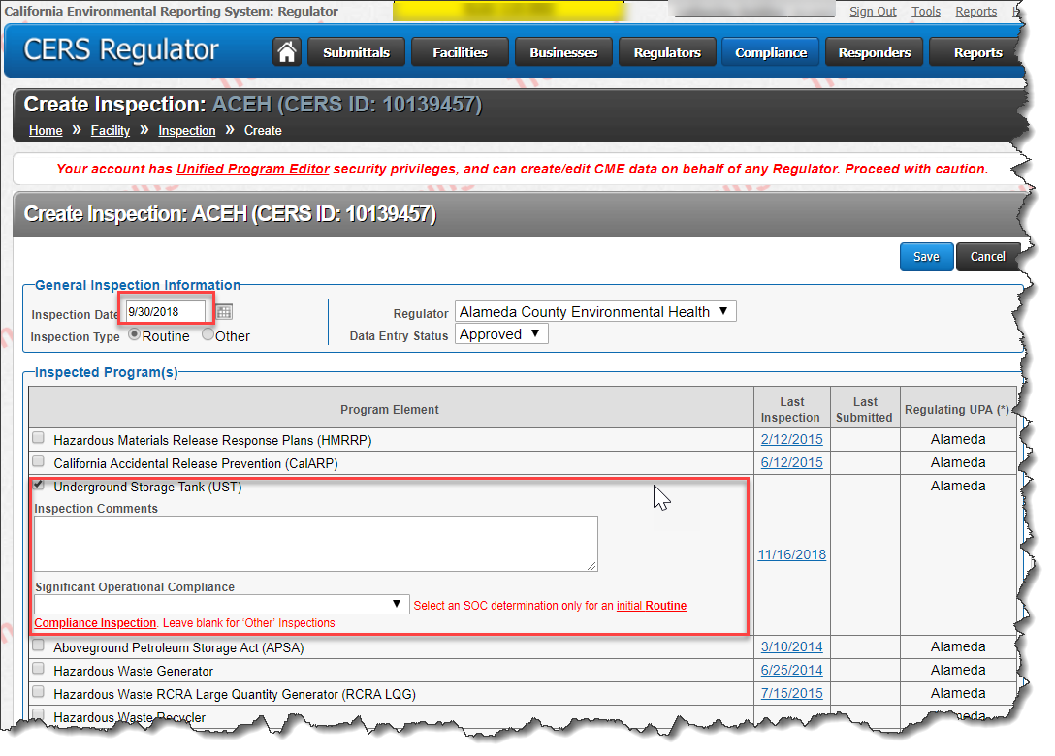
What Processes are Impacted?
CME (Compliance, Monitoring, and Enforcement)
Inspection Input
Inspection Occurred Prior to 10/1/2018
Inspection Occurred After 10/1/2018

Slide 25
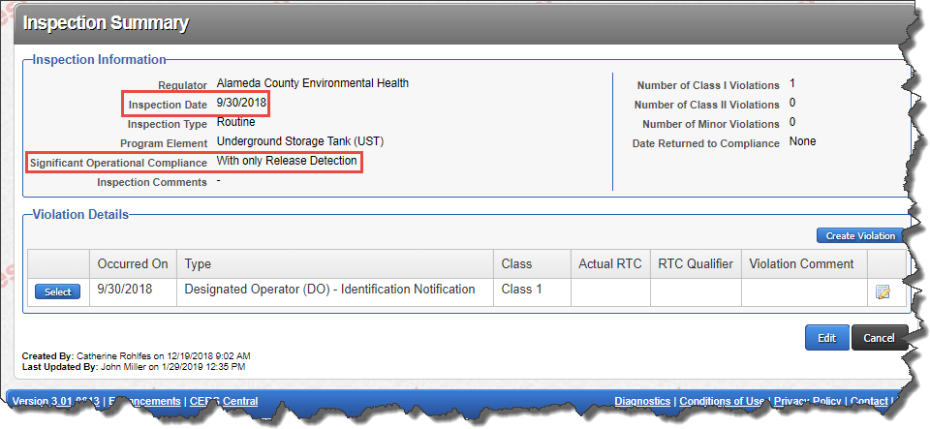
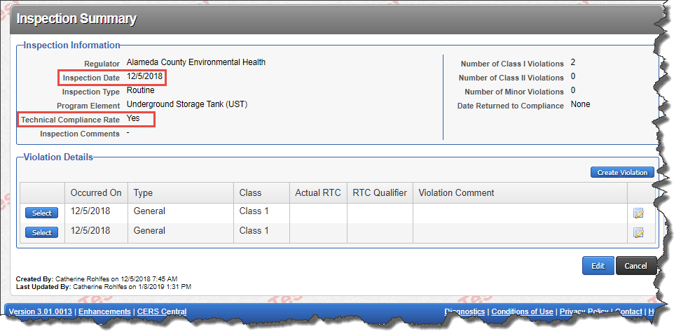
What Processes are Impacted?
CME (Compliance, Monitoring, and Enforcement)
Inspection Display
Inspection Occurred Prior to 10/1/2018
Inspection Occurred On or After 10/1/2018

Slide 26
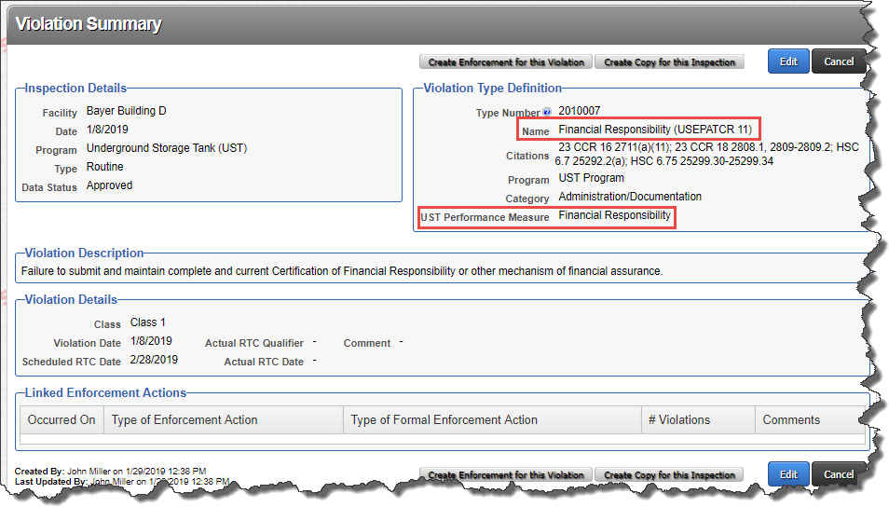
What Processes are Impacted?
CME (Compliance, Monitoring, and Enforcement)
Violation Display – Performance Measures/Technical Compliance Rate

Slide 27
What Processes are Impacted?
CME (Compliance, Monitoring, and Enforcement)
Violation Library Display – Performance Measures/Technical Compliance Rate

Slide 28
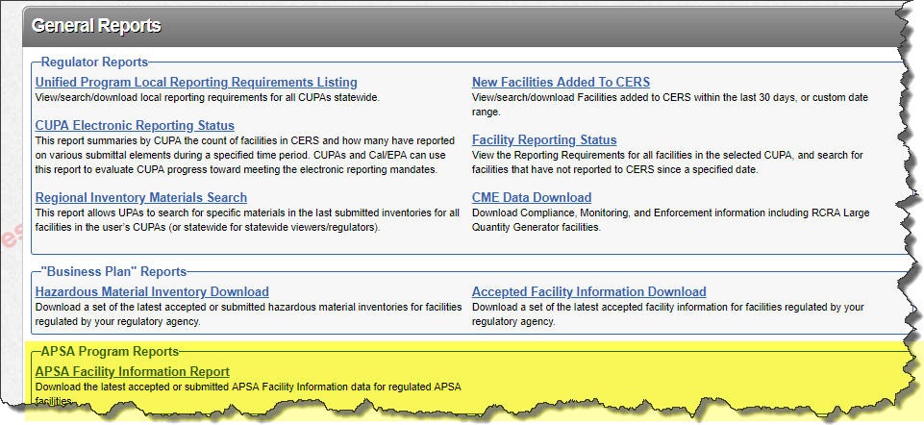
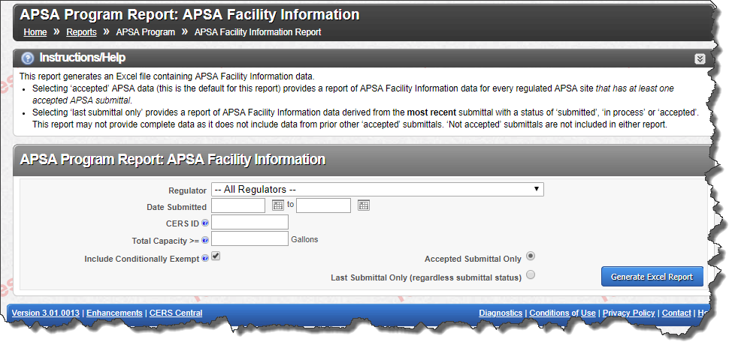
What Processes are Impacted?
Reports
Reports Added or Updated to Support New CERS 3 Features
New APSA Facility Information Report

Slide 29
What Processes are Impacted?
Reports Added or Updated to Support New CERS 3 Features
Updated CME Data Download and UST CME Data Download Reports to add Technical Compliance Rate calculation
Updated UST Facility/Tank Data Download Report to add CERS Tank ID
Updated all submittal printing features to include new data elements and data element codes
Updated Report 6 to support Performance Measures/Technical Compliance Rate and UST Reclassified Under APSA designation

Slide 30
What Processes are Impacted?
Reports
UST Report 6
Report 6 Summary
Report 6 Detail
Notes:
Explain Values
Summary: Represents Number of facilities compliant with each Performance Measure/TCR that were inspected during the date range specified
Detail: Represents compliance with each Performance Measure/TCR by facility where inspection occurred during the date range specified

Slide 31
What Processes are Impacted?
Electronic Data Transfer (EDT)
All APSA and UST related changes required schema and/or code updates
New submittal element resource and associated data elements
New data elements and data element codes
Updates to existing data elements
Processing code
CME changes did not affect EDT/schemas
Five schema package versions were released during the course of CERS 3 development
Versions 1.09 – 1.13
Version 1.13 is production release candidate
Schemas affected
Regulator Facility Submittal Query (Tier 2)
Regulator Facility Submittal Submit (Tier 6)
Regulator Facility Submittal Response (Tier 6)
Communication with EDT Implementers Community
Technical meetings for each feature release
Technical documentation released and posted to CERS Central for each schema package
Notifications communicated via ListServ
Notes:
Schema package and detailed change documentation for each release

Slide 32
CERS 3
Additional Information
Data element 106 Dun and Bradstreet updated in XML schema from integer to string to support leading zeroes
Removed from CERS 3 development plan
CR 212: Duplicate fields 430 (UST Type of Action) and 430a (Date UST Permanently Closed) in Regulator portal
Intent was to provide regulators a means of closing USTs through the Regulator portal
This CR was cancelled, as it was deemed to be non-compliant with Unified Program UST reporting regulations
CR 191: Auto Complete SOC Status Based on Selected Violations, CR 192: Violation Library – Identify RD and RP SOC Related Violations
These CRs were deprecated and replaced with new requirements due to the obsolescence of the Significant Operational Compliance determination, which was replaced by the Performance Measures/Technical Compliance Rate process and associated Violation Library updates that went into effect in October 2018 for the UST program

Slide 33
CERS 3
Challenges and Successes
CERS design/architecture complexity
New submittal element resource added
APSA Resource first new submittal element resource added to CERS since CERS 2 release
All aspects of CERS system were affected from end to end
Database structure, portals/UI, EDT, services
Valuable experience for team moving forward
UST process complexity (tracking USTs as entities)
Not consistent with CERS design
Team was able to overcome challenges and deliver solution
SCRUM/Agile process allowed team to be flexible with changing requirements and scope
Very good communication and collaboration with stakeholders
BOE Number change, UST processes, SOC obsolescence, etc.
Requirements weren’t fully vetted until development
CERS 2 production support and maintenance during CERS 3 development
CERS Team dynamics
Notes:
New resource: Our team first; previous team did not add resource after CERS 2 release
UST Process (design): CERS not designed to track USTs as entities, like facilities
UST Process (not part of scope): Team developed and implemented new processes in CERS to support CERS Tank ID that were not part of original scope
Team dynamics: Complimentary (skill sets/experience), work well together, good experience – lessons learned and opportunities for improvement in the future

Slide 34
CERS 3
Next Steps
Release and deployment planning
Communication with CUPA, business, and EDT Implementer communities
Work with Unified Program staff to develop and distribute guidance on process changes and new requirements via newsletters, ListServ, technical documentation, and CERS Central
Bi-weekly technical meetings with EDT Implementers Community to monitor development and testing progress, provide updates when necessary, and provide technical support
Review CERS 3 EDT test transactions
Provide ongoing technical support for EDT Implementers Community
Notes:
R & D planning: Comprehensive plan for deploying CERS 3 changes to Training, Staging, and Production environments

Slide 35
QUESTIONS
cers@CalEPA.ca.gov

Slide 36
Back up

Slide 37
2018
2019
Mar
Apr
May
Jun
Jul
Aug
Sep
Oct
Nov
Dec
Mar
APSA
Project Kickoff
Request 283 - New Data Field
Request 284 – Total Change Request 336: Add a new Valid Values for Tank Use and for Tank Content Aboveground Petroleum
Request 286: NEW APSA Submittal Element
Request 287: Modify DESCRIPTION
Request 314: Update EDT Schema
Request 536 – Dunn/Brad
UST
Change Request 195: Develop CERS Generated Unique UST ID numbers
Change Request 212: 2 NEW FIELDS: Duplicate fields 430 & 430a on Regulator Portal
Change Request 222: Modify Petroleum Tank Contents valid values
Request 12459: CERS 3 - Add new values to field 430 to indicate a tank transferred to or from the UST program to the AST program
Change Request 336: Add a new Valid Values for Tank Use and for Tank Contents
CME
Change Request 191: Auto Complete SOC
Change Request 192: Violation Library- Identify RD
Unit testing
Demo
Implementation preparation
Reports/Queries
Change Request 315: Modify Search Function
Change Request 279: New Report: Basic facility
Change Request 12381: Revise UST Report 6 to meet Federal TCR Reporting

Slide 38
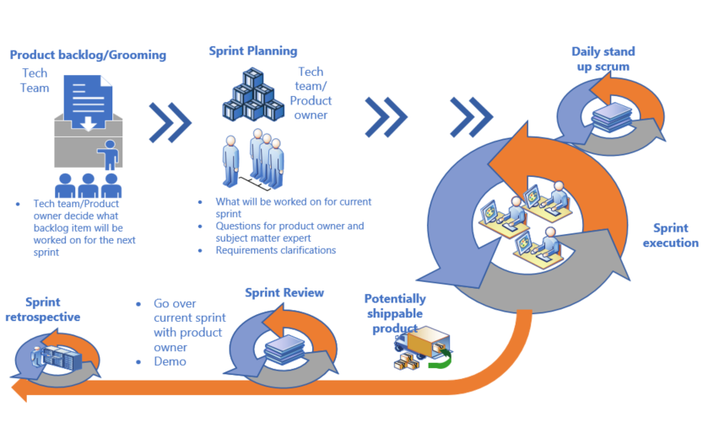
SCRUM at a Glance

